Slide 1

Data structure educational Resource
Minimum Viable Product
0.1.0ca4da0

Slide 2
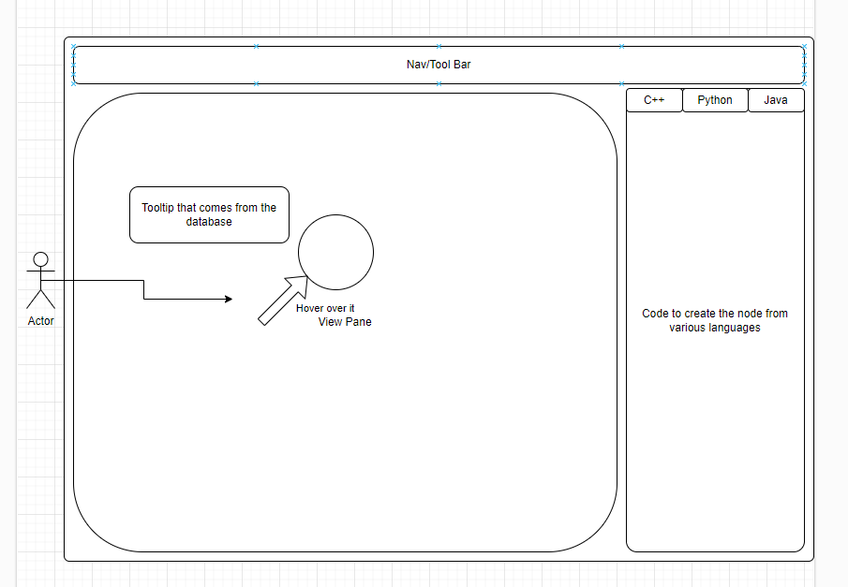
INTRODUCTION
What is the Project?
Noah
To create an application to present data structures through a visual editor to provide a visual tool of how data structures are built and can work together.
Storyboard: Produced 11/21/23 by Noah, Alex, Milad
Notes:
The goal was to create an application to fill the need that is surprisingly missing from the internet (at least in our combined experience).
A tool to visualize and instruct about data structures.
Taking inspiration from the drawio application that was used to create the storyboard, lets create an application where we can build data structures visually while also showing how the code would be built and used together.

Slide 3
Meet the team
Alex Shibley
Database Admin
Database Engineer
Cameron McHatton
UI Engineer
Milad Ale Ali
API Engineer
Noah Etchemendy
Product Owner
Git Management
Project Manager (PM)
Meet the Team
Noah

Slide 4
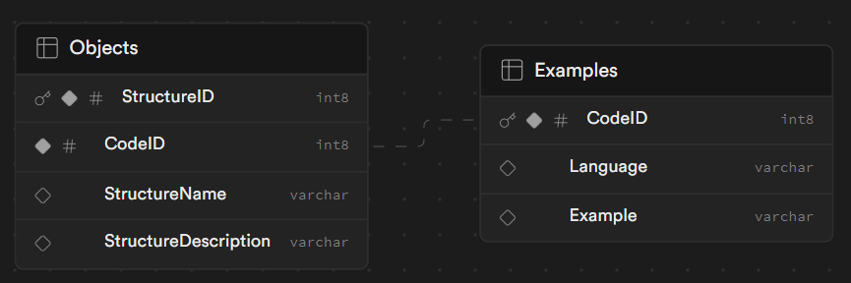
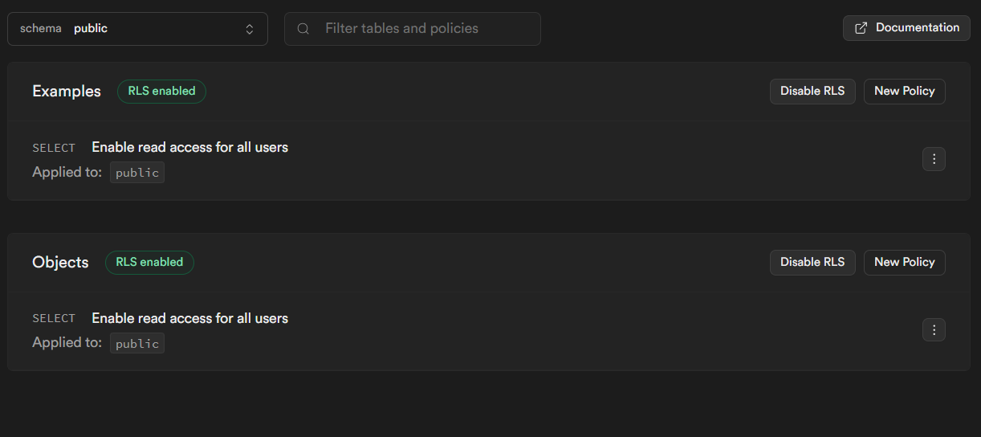


Database Provider
Alex
The objects provides information on each data structure that has been implemented.
The examples contains the code for the structures in the selected language.

Slide 5


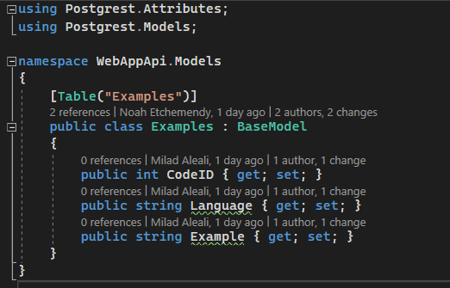
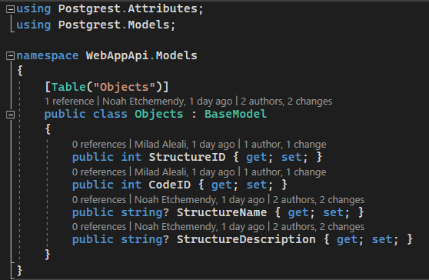
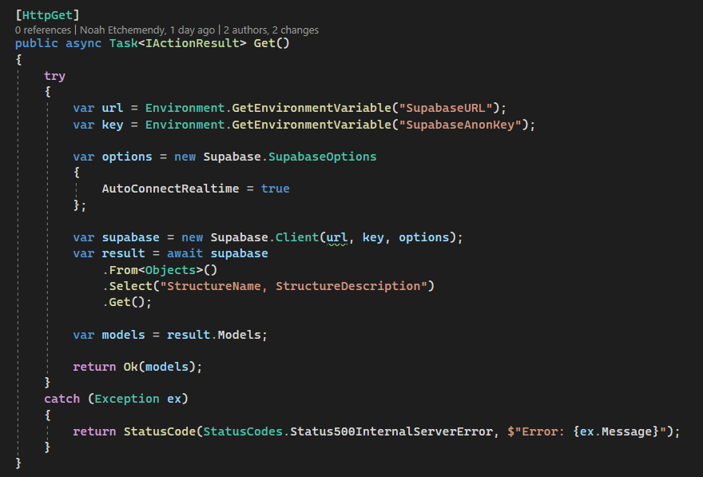
API Provider
Milad
Database
The API communicates through the library supabase-csharp to the database endpoint using environmental variables to protect the API keys.
Supabase
Anon Client
Request
JSON
Response
JSON
Response
API
UI
HTTP GET()
Request

Slide 6

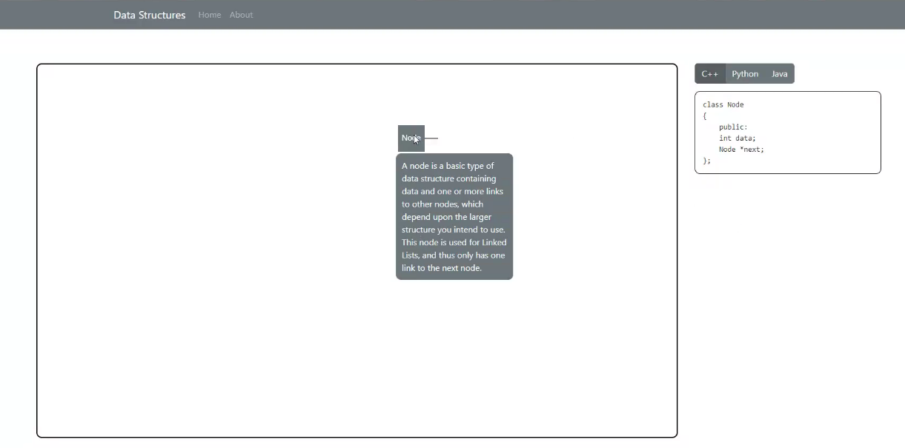





UI
Cameron
The UI combines many useful libraries provided to create the desired outcome.
-Vite
-React
-Bootstrap
-JavaScript
-Node.js
-VS Code

Slide 7
MVP Prototype requirements
Require Several Pages:
Single-page application Framework
Business Logic:
Done within API
Database Access:
Anon Public API Key with RLS
MVP Flow Logic:
Database
API
UI
Detailed use case, limited in scope:
The end user clicks the canvas to create a node at the point of the cursor and hovers over it to learn what a node is in C++
Chosen Alternate 1: … what a node is in Python
Chosen Alternate 2: … what a node is in Java
Actors: End user – A person who enters the site through a web browser on the computer
MVP requirements
Noah
Notes:
*Single-page application (SPA): a browser-based application that doesn't require the user to reload the page during operation

Slide 8
Infrastructure questions
Database: Alex, Noah
API: Milad, Noah
UI: Cameron, Noah

Slide 9
Thank you!
Notes:
Demo Time

